Slide 1
Epidemiology III Introduction and Review

Slide 2
Vocabulary
Association
Prevalence
Incidence
Proportion
Rate
Notes:
Maybe do this in Socrative. Maybe do this as part of lab.

Slide 3
Epidemiology
Uncertainty
Measurement
Study design
Notes:
This course isn’t intended to be a broad introduction to epidemiology. If you’re in this course, I expect that you’ve already had some exposure to the basics of epidemiology. Having said that, I would like to briefly touch on some basics of epidemiology as they apply to this course. Namely, I want to briefly discuss uncertainty, measurement, and study design.

Slide 4
Uncertainty
Few checklists
Notes:
In epidemiology generally, and parts of this course specifically, it will behoove us to become comfortable with uncertainty. When I say “uncertainty” here, I mean it in both a philosophical sense and in a very practical sense.
First, in a very practical sense, all students of epidemiology (including me) must get comfortable with the lack of reliable check-list procedures in epidemiology. What I mean is that students (including me) often wish that there was a simple checklist or algorithm that we could follow that will always lead us to the correct answer. Unfortunately, there are just very few such checklists in epidemiology – and in life for that matter. In reality, we will often have to rely on diligent research and experimentation to inform critical thinking and many (often untestable) assumptions. Clear-cut procedures that provide valid and reliable black and white answers are the exception rather than the rule. On the bright side, this should also provide us with some measure of job security for the foreseeable future. If epidemiology could simply be reduced to a checklist or algorithm, then our jobs would almost certainly be outsourced to computers in no time.

Slide 5
Uncertainty
Few checklists
Statistical uncertainty
Notes:
Second, it will behoove us to get comfortable with uncertainty in the statistical sense, which is something we will try to measure and quantify. Indeed, it may be an oversimplification, but not entirely inaccurate, to define statistics as the science of quantifying uncertainty. As least a certain type of uncertainty. It’s important to understand this type of uncertainty and become comfortable with it because data and statistics are probably the two most commonly used tools in the modern epidemiologist’s toolbox.

Slide 6
Uncertainty
Few checklists
Statistical uncertainty
Causal uncertainty
Notes:
And finally, it will behoove us to get comfortable with uncertainty on the level of our conclusions. In epidemiology, the questions we are called to answer are often causal questions. Did this cause that? If we stop this, can we stop that? On one hand, these questions are usually incredibly exciting and have the potential to lead to real, tangible changes in population health. On the other hand, our two primary tools -- data and statistics -- are not typically not sufficient to answer such questions in and of themselves. The conclusions that we are able to make are almost always loaded with caveats and assumptions. This is true even for many non-causal questions. However, the questions being asked are often so important that we don’t have the luxury of completely deferring our conclusions until some imaginary later date when the stars align, and the inner workings of the world are magically revealed to us with complete clarity. No, we must often do our best with the information and resources that are available to us now. Therefore, when we make conclusions, we will have to be comfortable with the fact that they may be wholly or partially incorrect, there may be important exceptions, and/or we may have to revisit them again in the future when circumstances, or the information available to us, changes. Even when they are entirely correct, we will often not be able to prove as much with complete certainty. Said another way, our conclusions will rarely, if ever, be exactly correct or provable; however, sometimes they will still be useful for a given purpose. That is an unsettling thought for many people. But it is true nevertheless and we must accept it and become comfortable with it if we want to practice epidemiology. If it makes you feel any better, the history of public health, including epidemiology, is littered with notable examples of useful conclusions that were not entirely correct or not entirely proven, yet still extremely useful. For example, citrus fruit to prevent and cure scurvy, drinking tainted drinking water as a cause of cholera, and tobacco smoke as a cause of lung cancer (and many other diseases).

Slide 7
Measurement
“the study of the occurrence and distribution of health-related states or events in specified populations, including the study of the determinants influencing such states, and the application of this knowledge to control the health problems.” (Porta 2008, page 81)
I usually say, “who gets sick or stays healthy, and why?”
Notes:
Epidemiology is typically defined as some version of, “the study of the occurrence and distribution of health-related states or events in specified populations, including the study of the determinants influencing such states, and the application of this knowledge to control the health problems.” (Porta 2008, page 81) I usually say, “who gets sick or stays healthy, and why.”

Slide 8
Measurement
“the study of the occurrence and distribution of health-related states or events in specified populations, including the study of the determinants influencing such states, and the application of this knowledge to control the health problems.” (Porta 2008, page 81)
I usually say, “who gets sick or stays healthy, and why?”
Observe and assign values to relevant characteristics.
Look for patterns among those values.
Notes:
Because this isn’t an introductory course on epidemiology, I’m not going to attempt to pick apart all the nuances of that definition. However, it may be worth taking a step back and thinking about how we study the occurrence and distribution of these things. Do we consult powerful oracles or deities? Not typically. Do we go into a deep meditative state until the answers just occur to us? Not typically. At least doing that alone would not typically be very convincing evidence to most people. Instead, we almost always study health-related states and populations by measuring characteristics of the health-related states or the populations that are thought to be relevant.
Then we look for useful patterns in those measurements. Recording those measurements typically results in data and looking for useful patterns typically occurs by applying statistical procedures to the data — hence, data and statistics are probably the two most commonly used tools in an epidemiologist’s toolbox.
I want to quickly note that the relevance of a characteristic is often based on previous observations and/or the relevance of the same characteristic(s) to similar health-related events or populations. And, when I say that we are “measuring characteristics,” I mean that we are recording numerical or qualitative values somewhere as we observe varying quantities or qualities of that characteristic. Sometimes, those values may be more or less dictated by nature (e.g., you have a certain genetic variation or you don’t), but sometimes they are assigned somewhat arbitrarily by us (e.g., mild, moderate, and severe pain). Note that this introduces yet another form of uncertainty, which will discuss later in the course.

Slide 9
Measurement
“the study of the occurrence and distribution of health-related states or events in specified populations, including the study of the determinants influencing such states, and the application of this knowledge to control the health problems.” (Porta 2008, page 81)
I usually say, “who gets sick or stays healthy, and why?”
Observe and assign values to relevant characteristics.
Look for patterns among those values.
Bottom line:
Describe
Predict
Causally explain
Notes:
If that all sounds a little too “deep” to be meaningful, I think the relevant take-away for our purposes is that a typical day in the life of most epidemiologists includes attempting to describe, predict, and/or causally explain health-related phenomena in populations of people, and we typically rely heavily on data, statistics, and assumptions to help us do that.

Slide 10
Description
Causation
Prediction
Notes:
Practically, the end result of of the measurement and analysis activities we just discussed are descriptions, predictions, and causal explanations of health-related phenomena. There may be some technical definitions somewhere that clearly distinguish each of these measurement and analysis goals, but in my experience, there is often some overlap between them in applied epidemiology. Further, the same study may attempt to do all three to varying degrees. Having said that, I think there is some value in taking a moment to discuss each individually.

Slide 11
Description
Not necessarily looking for associations.
Distributions (i.e., middle, spread, shape, proportion of people in each category) of single variables.
Resource management and planning.
Examples:
How many ventilators are available in Texas?
What is the average age of people living in Florida?
How much time elapses, on average, between exposure to a pathogen and occurrence of disease symptoms.
Notes:
When we say describe in this context, we are not necessarily looking for associations in the data between two or more variables. Rather, we are simply looking at the distribution of a single variable/measure. Typically, this is done in the context of resource management and/or planning.

Slide 12
Description
But, sometimes looking for associations.
Comparing distributions of single variables within levels of another variable.
Resource management and planning.
Examples:
Are there more ventilators available in Texas or New York?
Are people older, on average, in Florida or Pennsylvania?
Is symptom onset quicker, on average, for Cholera or E. coli?
Notes:
However, there are also times when we want to compare the distribution of one variable within levels of another variable. Most people would consider these comparisons to be equivalent to measuring associations. You could also make the case that this starts to overlap with prediction. However, when these distributions are being specifically used for resource management and planning, I would usually still consider the goal to be descriptive rather than predictive.

Slide 13
Description
Measures of disease occurrence.
Incidence
Prevalence
Odds
Can be useful on their own.
Can be useful for hypothesis generation.
Notes:
You can generally think of measures like incidence, prevalence, and odds as descriptive. We will cover those measures in greater detail later in the course. Often, these descriptive measures can be very useful in their own right, but they are also used as a foundation for hypothesis generation and prediction as well.

Slide 14
Prediction
Implies associations.
Notes:
When our goal is prediction, I think it is safe to say that our analyses will focus on associations. And what are associations?

Slide 15
Association
The distribution (i.e., middle, spread, shape, proportion of people in each category) of the thing we are measuring is different, on average, in two groups.
Knowing something about X tells you something about Y.
Notes:
Association exists when the distribution of the thing we are measuring is different, on average, in two groups. Alternatively, we can say that Knowing something about X tells you something (or helps you predict) about Y.

Slide 16
Prediction
Implies associations.
Examples
People of a certain race/ethnicity are more likely to get a particular cancer.
Older adults who have trouble managing finances are more likely to get dementia.
Can be useful on its own.
Often, in epidemiology, the ultimate goal is causal inference.
“the study of the occurrence and distribution of health-related states or events in specified populations, including the study of the determinants influencing such states, and the application of this knowledge to control the health problems.” (Porta 2008, page 81)
Notes:
Predictions, especially good ones, can obviously be useful on their own. We may know that people of a certain race/ethnicity are most likely to get a particular form of cancer. Knowing that may allow us to concentrate screening efforts more effectively. We may know that older adults who begin to have trouble managing their finances are more likely to develop dementia. We may be able to use that information as an early indicator of important health problems to come.
However, in epidemiology, we are very often not content with predictions alone. It is extremely common for our questions and studies to either directly ask causal questions or imply causal relationships between variables. The reason we are often more interested in causal associations than mere predictions can be found directly in our definition of epidemiology. We want to control health problems. Said another way, we want to know why ”bad” things happen so that we can stop them from happening and/or why “good” things happen so that we can make them happen more often.
This idea is simultaneously so straightforward and so complex. As we will see throughout the semester.
Notice that in the cases above these predictions may be perfectly valid, but do they get us any closer to our ultimate goal of “controlling health problems?” We can’t change anyone’s race or ethnicity, can we? Even if we could, I’m hard-pressed to think of an example of a health outcome that is caused directly by a person’s race or ethnicity. Race and ethnicity are just a proxy for the true unmeasured cause. Likewise, do you really believe that if we hired an accountant to help an older person manage their finances that they would no longer develop dementia? Of course not.

Slide 17
Causation (counterfactual prediction)
Believe it or not there is legitimate debate about whether or not causation is even a thing.
Let’s start with this assumption — things happen.
Ok, but why do they happen? For example, “I got in a car wreck today.” That’s a thing. “Why did I get in a car wreck today?”
Notes:
As I said, on the one hand, this is such a simple idea. We obviously have an intuitive understanding of cause and effect. If we didn’t, it’s doubtful that we could have survived this long.
On the other, this may surprise you, but I am not aware of any universally agreed upon definition of what a cause is or how to measure it. In fact, there are some schools of thought that “causation” is not even a real thing. Just a figment of our imagination.
I don’t want to go super deep into this conversation, because I don’t think it will ultimately be useful to you. However, I do want to briefly share my thoughts with you because, A) I can’t resist and B) it will serve as a starting point for our discussion moving forward.

Slide 18
Causation
Let’s start with this assumption — things happen. Ok, but why do they happen? For example, “I got in a car wreck today.” That’s a thing. “Why did I get in a car wreck today?”
No reason.
Predetermination.
Causation/causal inference.
Thing 1 -> Thing 2.
Counterfactual theory.
“If I see thing 2 happen, how do I figure out what thing 1 was?”
“How do I know thing 2 wouldn’t have happened if thing 1 hadn’t happened?”
“Does thing 2 always happen after thing 1 or just sometimes?”
“If I can figure out what thing 1 was and I do believe that thing 2 is likely to happen after thing 1, then what can I do about it?”
Notes:
At one end of the spectrum, we could say that there is no reason. Things happen spontaneously and totally at random. That could be true, but it just feels contrary to what most of us feel and observe all day every day. That doesn’t necessarily make it untrue, but at the very least, that theory is not useful for this course. If that were, in fact, true then there would be no reason to learn any of the other things we are going to learn in this course and you should not pay your tuition. More importantly, there are typically two main reasons for asking the question above, “Ok, but why do they happen?”
1. The first reason is to predict (formally or intuitively) if or when a similar thing will happen again. For example, “will I, or someone I care about, get in another car wreck tomorrow?”
2. The second reason is to try to control if or when a similar happens again. For example, “what can I do to prevent myself or someone I care about from getting in a car wreck tomorrow?” In epidemiology, the first reason we might simply call prediction and the second reason we often call an intervention. And, if things happen spontaneously and totally at random, then by definition, we can’t predict or control them.
An alternative explanation might be called predetermination. That is, things don’t happen at random. There is a reason. But, that reason, is unobservable (from the viewpoint of Western science) and uncontrollable. So, here we wouldn’t conclude that my car wreck today is spontaneous or random, but we would conclude that no matter what else happens, I will be in a car wreck today. This could also be true, but again, if it is, then we still can’t really predict or intervene on things so there is no real reason to move past this point in the course.
Yet another explanation (sometimes called a theory) is what we will refer to causation or causal inference. That is, thing 2 (effect) happened because thing 1 (cause) happened. And this is where it gets interesting. First of all, the statement above, “thing 2 (effect) happened because thing 1 (cause) happened,” implies that if thing 1 hadn’t happened then thing 2 also wouldn’t have happened. In this course, we will call that counterfactual theory. Of course, real life is complicated and logical next questions may be: “If I see thing 2 happen, how do I figure out what thing 1 was?”, and “how do I know thing 2 wouldn’t have happened if thing 1 hadn’t happened?”, and “does thing 2 always happen after thing 1 or just sometimes?”, and “if I can figure out what thing 1 was and I do believe that thing 2 is likely to happen after thing 1, then what can I do about it?”
For example, “How do I know I wouldn’t have gotten in a car wreck if I hadn’t run that red light? Maybe my steering system would have failed at the exact same moment and I still would have wrecked.” These are the kinds of questions we attempt to formalize (i.e., make measurable) and answer with the sufficient-component cause model and with causal diagrams. Together, counterfactuals, sufficient-component cause models, and causal diagrams may be grouped under the theory of causal inference. Understanding why they happen, how to predict them, and how to control them are the basic foundational questions to nearly all of epidemiology.

Slide 19
Confounding
Z
X
Y
Notes:
Because we often care about causality, we must also care about confounding. We will discuss confounding a lot this semester, but for now you can think of it as:
Mixing of effects
Giving credit to the wrong variable
Influence of another variable on our measure of association

Slide 20
Populations vs. samples
“the study of the occurrence and distribution of health-related states or events in specified populations, including the study of the determinants influencing such states, and the application of this knowledge to control the health problems.” (Porta 2008, page 81)
Sample can be a noun or a verb
Select = the people we ultimately study
Notes:
In epidemiology, we generally want to describe a population, predict the occurrence of something in a population, or explain the causes of something in a population. However, we generally cannot directly measure exposures and outcomes for every single member of the population. Instead, we have to select a sample of people from the population to take measurements from.
Sample can be a noun or a verb.
Select can mean “recruit”. It can also mean the records we have access to. It can also mean the people who happen to get ”sick”.

Slide 21
Measures
Observations
Experiments
Case
Descriptions
Ecological
Cross-sectional
Case-control
Cohort
Non-randomized
Randomized
Typically less convincing
Typically more convincing
Notes:
So, the next question might be, “how do we get the sample of people from the population we want to describe, make predictions about, and/or understand causes in?” Well, there are many different ways!
It’s important that we classify the different ways that we can sample people to take measurements from because each of the different ways has its own set of strengths and weaknesses that we need to be aware of. Today, we will just briefly introduce some of the most common ways to sample people to gather measurements from – also known as study designs – used in epidemiology.
At the first first level, we typically categorize a study designs as either experimental or observational.
Experiments are studies in which the researcher has control over who is exposed to something and who isn’t. We won’t talk a lot about how to do an experimental study in this course. However, we will will talk about a particular kind of experimental study – the randomized controlled trial – as a way to help us understand causal inference later in the course.
In observational studies, the person, nature, society, or some force other than the researcher controls who is exposed to something and who isn’t. Observational studies make up the vast majority of epidemiologic studies. In particular, we will focus heavily on cross-sectional studies, case-control studies, and cohort studies in this course.

Slide 22
Basic cohort study design
Outcome Measured
in Exposed
Cohort Identified
Exposure Measured
Incidence Proportion
Exposure Occurrence
Compare Incidence Proportion
Outcome Measured
in Unexposed
Incidence Proportion
Where:
Orange = Exposed
Blue = Unexposed
Circle = No Outcome
Triangle = Outcome
Time
Notes:
Here’s my little graphical representation of the basic prospective cohort design. Exposures that we are interested in occur out in the world, but the outcomes have not yet occurred. Then, we come along and measure these exposures and classify a group of people (a cohort) as exposed or unexposed. Then, we let some time pass and we see if more exposed people or more unexposed people develop the outcome(s) we are interested in.

Slide 23
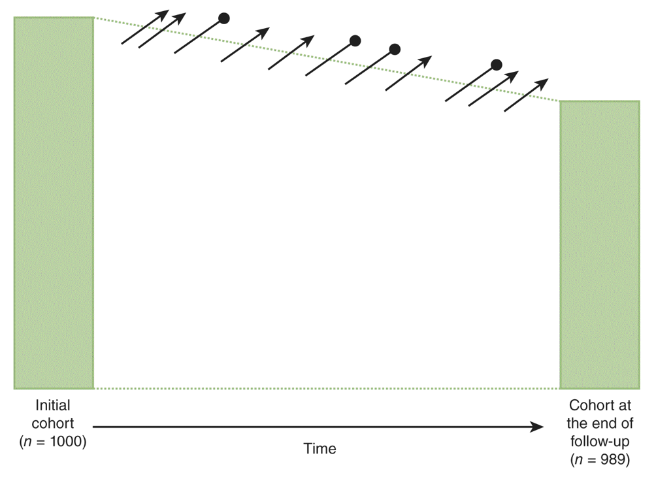
Notes:
And here is how the textbook draws it.

Slide 24
Basic case-based case-control study design
Population of interest
Cases Identified
Exposure Measured
Calculate Odds
Compare Odds
Controls Identified
Exposure Measured
Calculate Odds
Time
Notes:
Here’s my little graphical representation of the basic case-based case-control study design. There are other case-control designs, but when someone simply says, “case-control” study, this is probably what they are talking about.
In this design, exposures and outcomes that we are interested in occur out in the world. Then, we come along and gather up a group of people who have already had the outcome we are interested in and then measure their history of exposures(s). Similarly, we gather up a group of people who we think are comparable to the people with the outcome in all relevant ways, but who haven’t had the outcome, and we also measure their history of exposure(s). Finally, we calculate the odds of being exposed in both groups and compare.
Where:
Orange = Exposed to smoking
Blue = Unexposed to smoking
Circle = No lung cancer
Triangle = Lung cancer
This is a very simplistic description, but it’s intended to just give you an intuitive feel for what we are talking about.

Slide 25
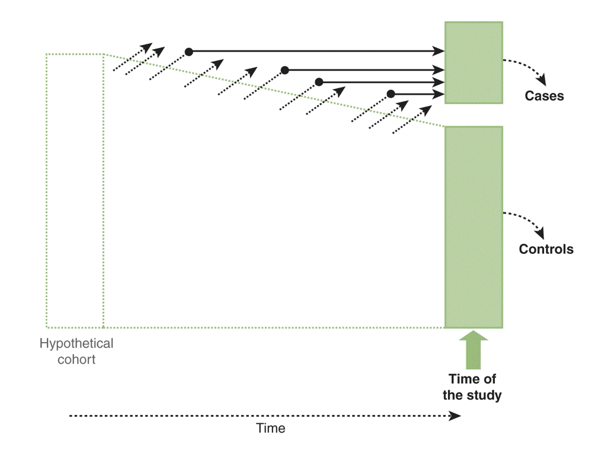
Notes:
And once again, this is how your textbook represents the case-based case-control study design graphically.
Note, that they have “hypothetical cohort” written on the left-hand side. They do this to reinforce the idea that a properly designed and executed case-control study can be thought of as a more efficient version of a cohort study. We’ll talk more about that later in the course.

Slide 26
Basic cross-sectional study design
Sample Selected
Exposure Measured
and Outcome Measured
Population of Interest
Calculate Prevalence
Compare Prevalence
Calculate Prevalence
Time
Notes:
But, when we use a cross-sectional study design we simultaneously measure exposures and outcomes at a single point in time. So here, we have a population of interest were exposures and outcomes have occurred out in the world. We come along and take a sample of the population and measure the exposures and outcomes at the same time.
For example:
Orange = Exposed to hepatitis B virus
Blue = Unexposed to hepatitis B virus
Circle = No aplastic anemia
Triangle = Aplastic anemia
Let’s stop on notice a couple things here:
First, notice here that there is some ambiguity about which is the exposure and which is the outcome (or more precisely, which is the cause and which is the effect).
Second, notice that now we must use prevalence as our measure of disease occurrence.

Slide 27
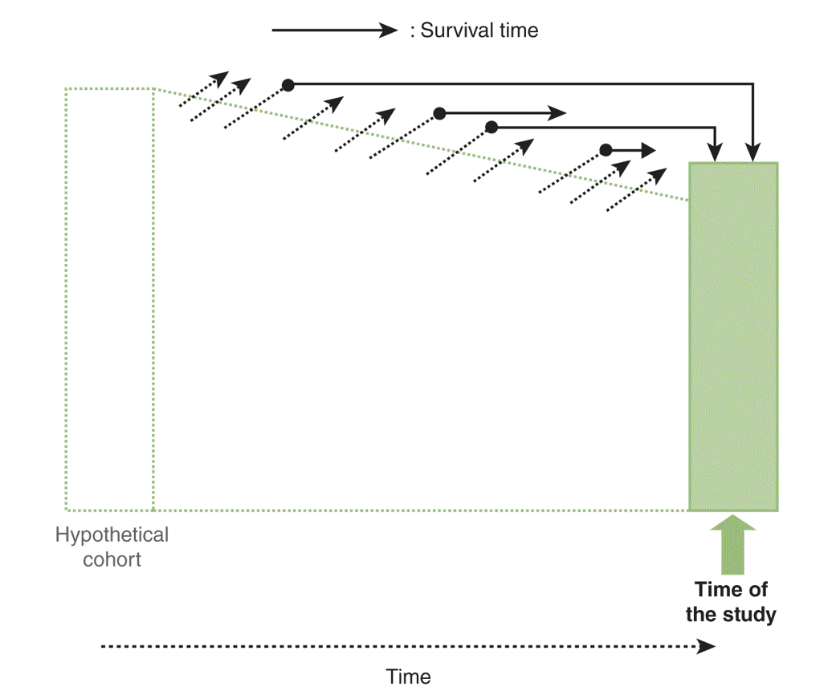
Notes:
And again, here is how the textbook represents it.
I also want you to notice a third thing here. I think it stands out a little more clearly in this graphic. By measuring prevalent cases (as opposed to incident cases) we are giving preference to people who survive longer with the outcome. Said another way, the ratio of people who get the outcome and die quickly to people who get the outcome and survive for a relatively long time may be different when we use a cross-sectional study design vs a cohort design.
** Socrative 2

Slide 28
Basic cross-sectional study design
Sample Selected
Exposure Measured
and Outcome Measured
Population of Interest
Calculate Prevalence
Compare Prevalence
Calculate Prevalence
Time
Notes:
When we use a cross-sectional study design, we simultaneously measure exposures and outcomes at a single point in time. So here, we have a population of interest were exposures and outcomes have occurred out in the world. We come along and take a sample of the population and measure the exposures and outcomes at the same time.
For example:
Orange = Exposed to hepatitis B virus
Blue = Unexposed to hepatitis B virus
Circle = No aplastic anemia
Triangle = Aplastic anemia

Slide 29
Notes:
And again, here is how the textbook represents it.

Slide 30
Measures
Observations
Experiments
Case
Descriptions
Ecological
Cross-sectional
Case-control
Cohort
Non-randomized
Randomized
Typically less convincing
Typically more convincing
Notes:
We will talk more about cross-sectional studies and this diagram later in the course. For now, I just want you to have a general feel for the different study designs and what some of their defining characteristics are.
Finally, as you can see in the diagram above, the results we get from some studies are sometimes seen as less convincing, or “weaker evidence”, than those we get from other studies. This perception isn’t always valid, but where it is, it is primarily a result of likelihood of bias error to occur.

Slide 31
Measure
Truth
Error
Random
(Sampling)
Systematic
(Bias)
Notes:
When it comes to research, the term “error” has a specific meaning. I think it’s easiest to understand in the context of measurement.
Remember that we are almost always trying to describe, predict, or explain causes in our population. To do that, we measure thing in people. Those measures that we take can be thought of as a mix of the truth and error.
For example, if the average age of our population of interest is 55, then any measure of the average age that differs from 55 differs from the truth – it has error.
In this sense, error can simply be taken to mean the literal difference between our measurement and the truth. It doesn’t have to be any more complicated than that. Later, our description of errors will get more detailed, and our discussion of the effects of errors will get more specific, but we will still be having a more detailed and specific discussion about this basic idea – the difference between our estimate and the truth.
Error in our measurement can further be categorized into random error and systematic error.
Random error refers to the differences between our conclusions and the truth that are caused by the fact that our estimate of the truth is made from the analysis of a sample of people from our population rather than all the people in our population. With random error, our estimates differs from the truth, but tend to lie all around the truth, seemingly at random. This type of error is a focus of statistics. We will discuss some statistics in this course, but this course is not a statistics course.
Systematic error refers to the differences between our conclusions and the truth that are caused by the way we collected our data or conducted our analysis. This is a general category of error is also referred to as bias. Bias is an incredibly important concept in epidemiology, and we will discuss it often in this course.

